Slide 1
The Right Rate for the Risk
Modeling Applications in Auto Insurance
Courtney Rohde, ACAS
Math Modeling 3338 - 8/28/2019

Slide 2
Intro to Auto Insurance
Policy Premium = Σ(Vehicle Premiums)
Vehicle Premium = Σ(Policy Premiums), e.g. Bodily Injury, Collision, Towing & Labor
Coverage Premium = Base Rate × Π(Factors) + Expense Fees
e.g. $200 × 1.2 × 0.75 × 1.15 + $5.50 = $212.50
where:
Age Factor = 1.2
Vehicle Model Year Factor = 0.75
Lower Deductible Factor = 1.15
Base rates and factors must be approved by state governments
Relative Losses
Overall Losses

Slide 3
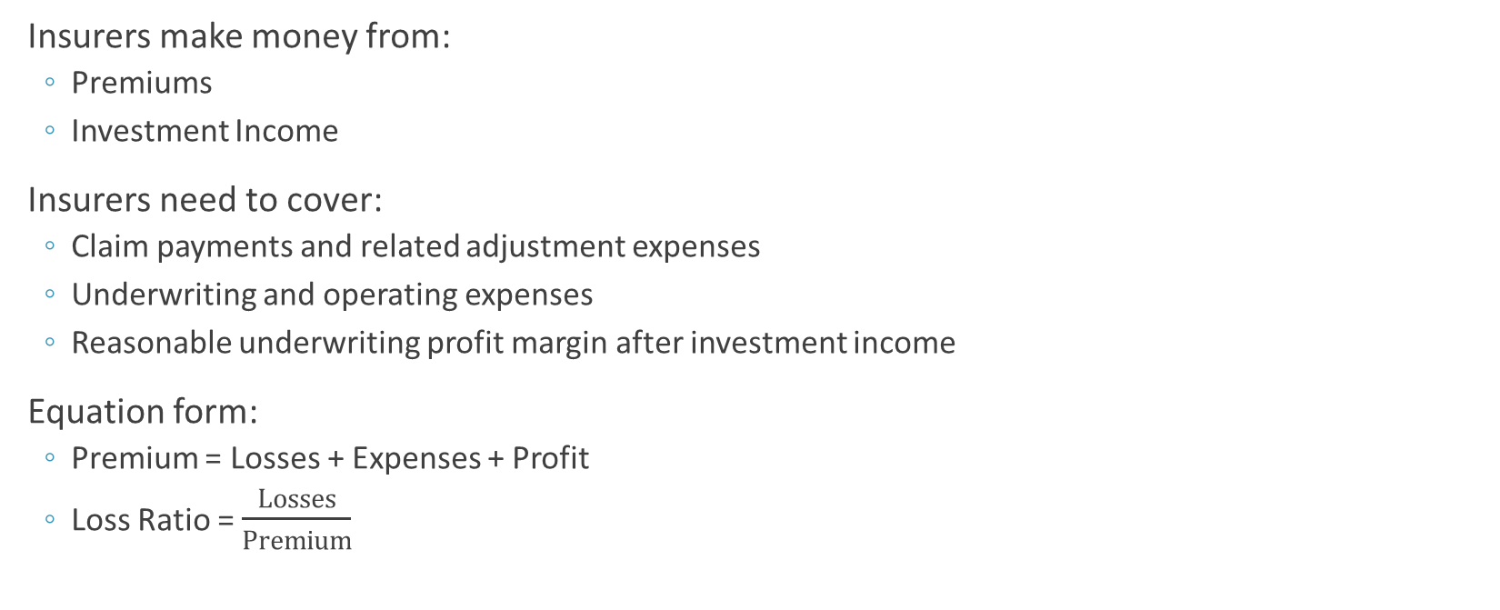
The Base Rate
How much total premium do we need to bring in?
Insurers make money from:
Premiums
Investment Income
Insurers need to cover:
Claim payments and related adjustment expenses
Underwriting and operating expenses
Reasonable underwriting profit margin after investment income
Equation form:
Premium = Losses + Expenses + Profit
Loss Ratio = $\frac{Losses}{Premium}$

Slide 4
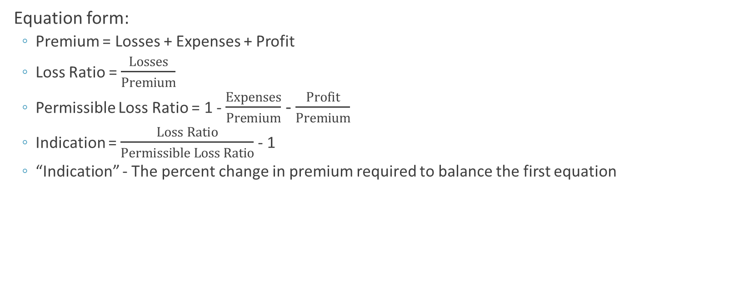
The Base Rate
How much total premium do we need to bring in?
Equation form:
Premium = Losses + Expenses + Profit
Loss Ratio = $\frac{Losses}{Premium}$
Permissible Loss Ratio = 1 - $\frac{Expenses}{Premium}$ - $\frac{Profit}{Premium}$
Indication = $\frac{Loss Ratio}{Permissible Loss Ratio}$ - 1
“Indication” - The percent change in premium required to balance the first equation

Slide 5
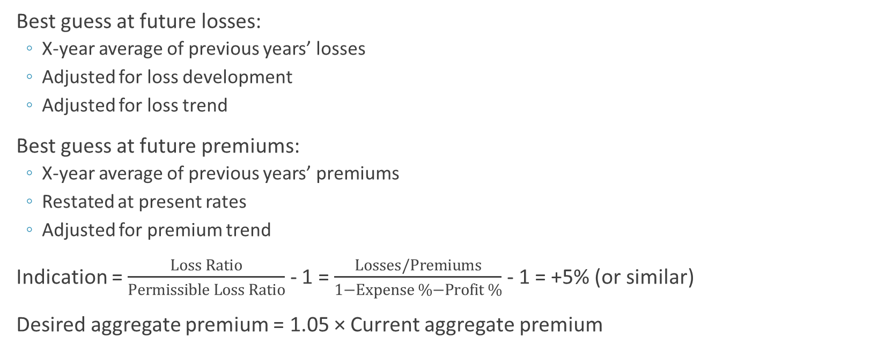
The Base Rate
How much total premium do we need to bring in?
Best guess at future losses:
X-year average of previous years’ losses
Adjusted for loss development
Adjusted for loss trend
Best guess at future premiums:
X-year average of previous years’ premiums
Restated at present rates
Adjusted for premium trend
Indication = $\frac{Loss Ratio}{Permissible Loss Ratio}$ - 1 = $\frac{Losses/Premiums}{1−Expense \%−Profit \%}$ - 1 = +5% (or similar)
Desired aggregate premium = 1.05 × Current aggregate premium

Slide 6
The Big Modeling Question
Given a set of policy & vehicle characteristics, what is the expected loss?
If we know the expected losses for each vehicle, we can calculate the relative difference in expected losses as the characteristics vary.
E(LossAge₂₁) = 1.2 × E(LossAge₄₀)
We want to know:
What characteristics impact expected loss?
What is the direction of the impact? (discount vs. surcharge)
What is the magnitude of the impact?
Charging the right rate for the risk matters.
When safe policies subsidize risky policies, the company can experience Adverse Selection

Slide 7
Definition of a Loss
What are we actually modeling?
Two components of “Loss”
Whether it happens or not: Frequency = Claim Count ÷ Exposure
For example: one car insured for six months has one claim. Observed frequency: 1 ÷ 0.5 = 2
When it happens, how expensive it is: Severity = Claim Amount ÷ Claim Count
For example: The claim costs us $2000. Observed severity: 2000 ÷ 1 = 2000
Either Frequency or Severity could be the response variable (the Y)
We model Pure Premium = Frequency × Severity
For example: The claim above has Observed pure premium: 2 x 2000 = 4000
Accounts for both components
Half as many models to maintain

Slide 8
The Data
Example Model Input
Vehicle ID | Oper Age | MYR | Deductible | Claim Count | Claim Amount | Earned Exposure | Pure Premium
1 | 41 | 2014 | 0500 | 0 | 0 | 0.5 | 0
2 | 60 | 2016 | 1000 | 0 | 0 | 0.1 | 0
3 | 29 | 2011 | 0500 | 1 | 12750 | 0.5 | 25500
4 | 30 | 2015 | 0250 | 0 | 0 | 0.5 | 0
5 | 52 | 2014 | 0500 | 1 | 1400 | 0.5 | 2800
6 | 17 | 2001 | 0250 | 0 | 0 | 0.5 | 0
Predictors (X_{i})
Response (Y)

Slide 9
Linear Regression
Ordinary Least Squares
Minimize the total square error
Assumes:
Does not work well for loss distributions

Slide 10
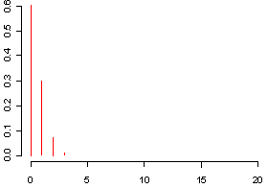
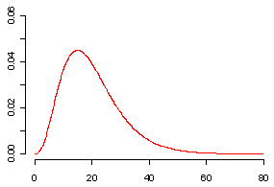
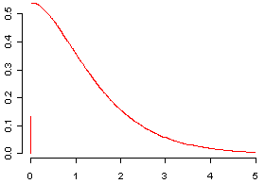
Distribution of Response
Frequency
Severity
Pure Premium
Poisson: σ²=μ
Gamma: σ²=μ²
Tweedie: σ²=μ^{p}
All members of the Exponential Family

Slide 11
Generalized Linear Models
More Flexible
Allows any error distribution in the Exponential Family
Allows for multiplicative predictors via a link function g(μ)
Link function defines the relationship between the response and the linear combination of predictors
Ordinary Linear Model
Generalized Linear Model
Expected Loss
Base Rate
Factor
Log Link

Slide 12
From GLM Formula to Rating Algorithm
Base Rate × Age Factor × MYR Factor × Deductible Factor

Slide 13
Project Phase I
What are we going to be doing?
Calculate indicated rate change:
Formulaic, not interesting
I will provide a workbook and you will fill in the blanks
Run the first GLM:
Very interesting!
Download R (free statistical software) & relevant packages
Learn basic functions & syntax with demo
Flesh out code I will provide using functions you learned
Contains both classical linear model and GLM
Run the code

Slide 14
Project Phase II
What are we going to be doing?
Improve the GLM:
Simplify variables to get better parameter estimates
Drop or group away insignificant parameters
Select Rating Factors
Based on your model estimated parameter coefficients
Competitive concerns (to be outlined later)
And common sense
Calculate the new base rate:
That will result in new aggregate premium satisfying equations from first few slides

Slide 15
Project Phase III
What are we going to be doing?
Calculate old/new premiums:
Evaluate dislocation
Evaluate the GLM:
“Score” data set (calculate expected losses) using
Model parameter estimates
Selected factors
Old factors
Metrics TBD, probably calculate a Gini coefficient and/or plot the fit to actual data
Present your findings

